Slide 1
Critical Thinking: A Student’s Introduction
Chapter 9
A Little Categorical Logic
© 2019 McGraw-Hill Companies. All Rights Reserved.

Slide 2
Categorical Statements
Categorical statement: Makes a claim about the relationship between two or more categories or classes of things
Standard-form categorical statements
All S are P (example, All Democrats are liberals)
No S are P (example, No Democrats are liberals)
Some S are P (example, Some Democrats are liberals)
Some S are not P (example, Some Democrats are not liberals)

Slide 3
Venn Diagram, 1
Method to represent categorical statements (or test categorical arguments) with a series of overlapping circles that represent the suggested groups and their relations
Each circle represents a group
Partially overlapping circles denote that the groups share similarities

Slide 4
Venn Diagram, 2
An “X” in a portion of a circle entails that there is at least one thing within that portion
Coloring in a portion of a circle entails that there is nothing within that portion

Slide 5
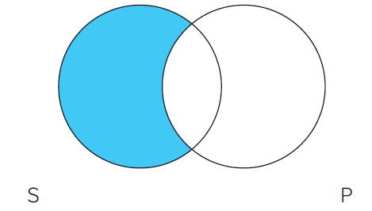
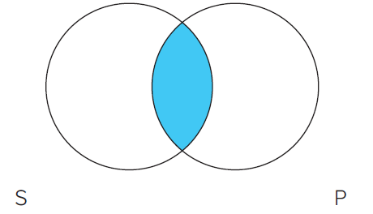
Standard-Form Examples, 1
All S are P
No S are P
Jump to Standard-Form Examples, 1, Appendix 1
Jump to Standard-Form Examples, 1, Appendix 2

Slide 6
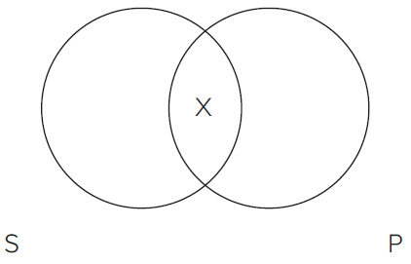
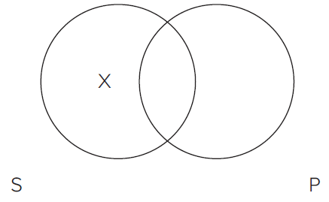
Standard-Form Examples, 2
Some S are P
Some S are not P
Jump to Standard-Form Examples, 2, Appendix 1
Jump to Standard-Form Examples, 2, Appendix 2

Slide 7
Parts of a Statement, 1
Quantifiers: Express a quantity or a number
Examples: All, no, or some
Subject term: Word or phrase that names a class and that serves as the grammatical subject of a sentence
Example: In “Some students are not voters,” the subject term is “students”

Slide 8
Parts of a Statement, 2
Predicate term: Word or phrase that names a class and that serves as the subject complement of the sentence
Example: In the statement “No prime ministers are prime numbers,” the predicate term is “prime numbers”
Copula: Linking verb
Example: In the statement “Some students are double majors,” the copula is “are”

Slide 9
Tips for Translating Sentences into Standard Categorical Form, 1
Tip 1: Rephrase all nonstandard subject and predicate terms so that they refer to classes
Example: “All actors are vain” becomes “All actors are vain people”
Tip 2: Rephrase all nonstandard verbs
Example: “Some students walk to school” becomes “Some students are persons who walk to school”

Slide 10
Tips for Translating Sentences into Standard Categorical Form, 2
Tip 3: Fill in any unexpressed quantifiers
Examples:
“Koalas are marsupials” becomes “All Koalas are marsupials”
“Californians are health nuts” becomes “Some Californians are health nuts” (in cases such as this, interpret the speaker’s or writer’s intent as charitably as possible)

Slide 11
Tips for Translating Sentences into Standard Categorical Form, 3
Tip 4: Translate singular statements as all or no statements
Singular statement: Makes a claim about a particular person, place, or thing
Example: “This flower is blooming” becomes “All things (that are) identical with this (particular) flower are things that are blooming”

Slide 12
Tips for Translating Sentences into Standard Categorical Form, 4
Tip 5: Translate stylistic variants into the appropriate categorical form
Example: “Mary is loved by John” becomes “John loves Mary”
See lists on page 244 to 248

Slide 13
Categorical Syllogisms
Syllogism: Three-line deductive argument
Categorical syllogism: Syllogism made up of all categorical statements
Example
No doctors are professional wrestlers
All cardiologists are doctors
So, no cardiologists are professional wrestlers
Let’s look at how to evaluate this argument with a Venn Diagram

Slide 14
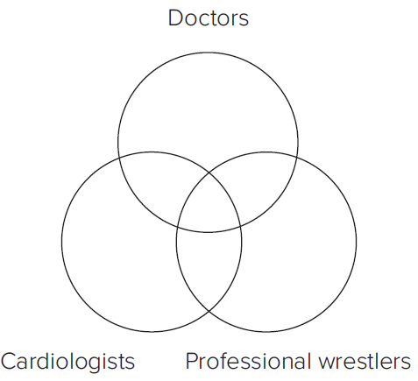
Using Venn Diagrams to Test Validity, 1
Since there are three category terms (doctors, cardiologists, and professional wrestlers), we need three interlocking circles
Jump to Using Venn Diagrams to Test Validity, 1, Appendix

Slide 15
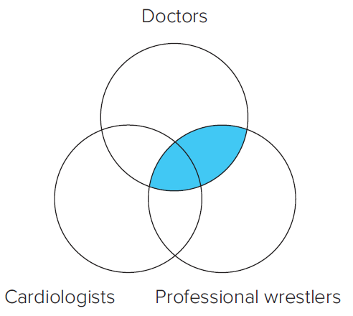
Using Venn Diagrams to Test Validity, 2
No doctors are professional wrestlers
Jump to Using Venn Diagrams to Test Validity, 2, Appendix

Slide 16
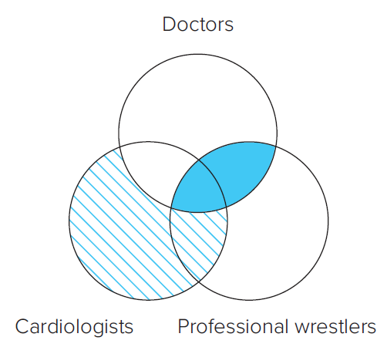
Using Venn Diagrams to Test Validity, 3
No doctors are professional wrestlers
All cardiologists are doctors
So, no cardiologists are professional wrestlers
Since the conclusion suggests the shared area between Cardiologists and Pro Wrestlers is empty (shaded), and the first two premises already shaded that area, the argument is valid
Jump to Using Venn Diagrams to Test Validity, 3, Appendix

Slide 17
Rules for Diagramming “Some” Statements, 1
If an argument contains one all or no statement, always do any necessary shading before placing an X
If the argument contains two all or no statements, either statement can be done first
If part of the placement area has already been shaded, place the X in the unshaded area

Slide 18
Rules for Diagramming “Some” Statements, 2
When placing an X in an area, if neither part of the area has been shaded, place the X on the line that separates the two parts (see examples on page 253 and 254)

Slide 19
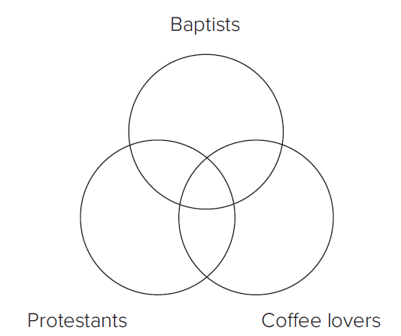
“Some” Statements: Example, 1
Some Baptists are coffee lovers
All Baptists are Protestants
So, some Protestants are coffee lovers
Jump to “Some” Statements: Example, 1, Appendix

Slide 20
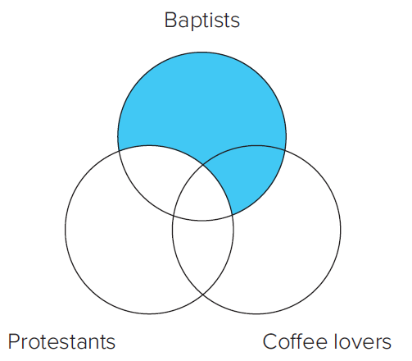
“Some” Statements: Example, 2
All Baptists are Protestants
Notice we do the “all” statement first because it requires shading
Jump to “Some” Statements: Example, 2, Appendix

Slide 21
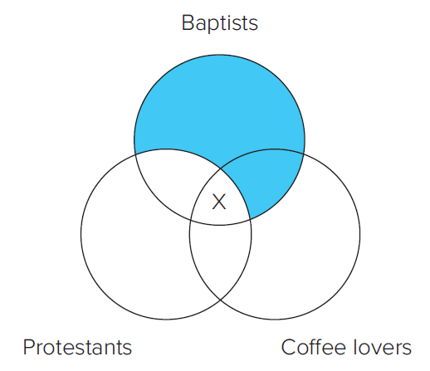
“Some” Statements: Example, 3
Some Baptists are coffee lovers
Since part of the area that represents the overlap of Baptists and coffee lovers is already shaded, we place the “X” in the unshaded part of that overlap
All Baptists are Protestants
Jump to “Some” Statements: Example, 3, Appendix

Slide 22
“Some” Statements: Example, 4
Some Baptists are coffee lovers
All Baptists are Protestants
So, some Protestants are coffee lovers
Since the conclusion suggests that there is at least one individual within the overlap of Protestants and coffee lovers, and the first two premises place an “X” in that area, the argument is valid
Jump to “Some” Statements: Example, 4, Appendix

Slide 23
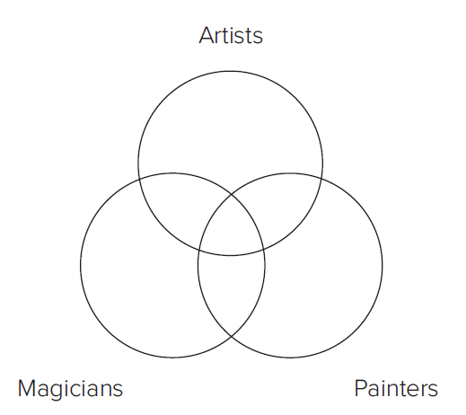
Diagramming When an Argument is Invalid: Example, 1
All painters are artists
Some magicians are artists
So, some magicians are painters
Jump to Diagramming When an Argument is Invalid: Example, 1, Appendix

Slide 24
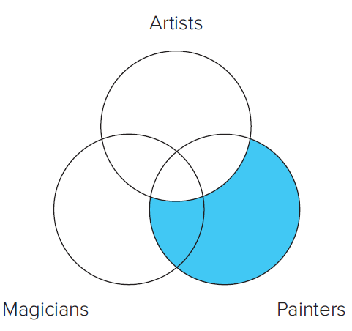
Diagramming When an Argument is Invalid: Example, 2
All painters are artists
Notice we start with the first premise because it is an “all” statement and thus requires shading
Jump to Diagramming When an Argument is Invalid: Example, 2, Appendix

Slide 25
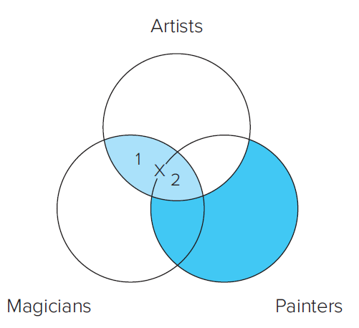
Diagramming When an Argument is Invalid: Example, 3
All painters are artists
Some magicians are artists
We place an X in that portion of the Magicians circle that overlaps with the Artists circle to represent the claim
The area is divided into two parts (“1” and “2”)
We have no information that warrants placing the X in one of these areas rather than the other. In such cases, we place the X precisely on the line between the two sections.
Jump to Diagramming When an Argument is Invalid: Example, 3, Appendix

Slide 26
Diagramming When an Argument is Invalid: Example, 4
All painters are artists
Some magicians are artists
So, some magicians are painters
There is an X in the Magicians circle, but it dangles on the line between the Artists circle and the Painters circle. We don’t know whether it is inside or outside the Painters circle. Consequently, the argument is invalid.
Jump to Diagramming When an Argument is Invalid: Example, 4, Appendix

Slide 27
Using Venn Diagrams to Test the Validity of Categorical Syllogisms, 1
Step 1: Translate all statements in the argument (if necessary) into standard-form categorical statements
Step 2: Draw and label three overlapping circles
One for each term (class name) in the argument, with the two circles for the conclusion at the bottom
Step 3: Use shading to represent the information in all or no statements and use X’s to represent the information in “some” statements

Slide 28
Using Venn Diagrams to Test the Validity of Categorical Syllogisms, 2
Step 4: Diagram the two premises
No marks should be entered for the conclusion
Step 5: When placing an X in a two-part area, if one part of the area has been shaded, place the X in the unshaded part
If neither part of the area has been shaded, place the X precisely on the line separating the two parts

Slide 29
Using Venn Diagrams to Test the Validity of Categorical Syllogisms, 3
Step 6: Look to see if the diagram contains all the information presented in the conclusion
If it does, the argument is valid
If it doesn’t, the argument is invalid

Slide 30
Appendices

Slide 31
Standard-Form Examples, 1, Appendix 1
The Venn diagram contains two partially overlapping circles. The circle on the left is labeled S and is shaded. The circle on the right is labeled P.
Jump back to Standard-Form Examples, 1

Slide 32
Standard-Form Examples, 1, Appendix 2
The Venn diagram contains two partially overlapping circles. The circle on the left is labeled S, and the circle on the right is labeled P. The area where the circles overlap is shaded.
Jump back to Standard-Form Examples, 1

Slide 33
Standard-Form Examples, 2, Appendix 1
The Venn diagram contains two partially overlapping circles. The circle on the left is labeled S, and the circle on the right is labeled P. The area where the circles overlap contains an X.
Jump back to Standard-Form Examples, 2

Slide 34
Standard-Form Examples, 2, Appendix 2
The Venn diagram contains two partially overlapping circles. The circle on the left is labeled S, and the circle on the right is labeled P. The circle on the left contains an X.
Jump back to Standard-Form Examples, 2

Slide 35
Using Venn Diagrams to Test Validity, 1, Appendix
The Venn diagram represents the statements “No doctors are professional wrestlers. All cardiologists are doctors. So, no cardiologists are professional wrestlers.” The diagram contains three partially overlapping circles. In a clockwise direction, the first circle is labeled doctors, the second circle is labeled professional wrestlers, and the third circle is labeled cardiologists.
Jump back to Using Venn Diagrams to Test Validity, 1

Slide 36
Using Venn Diagrams to Test Validity, 2, Appendix
The Venn diagram represents the statements “No doctors are professional wrestlers. All cardiologists are doctors. So, no cardiologists are professional wrestlers.” The diagram contains three partially overlapping circles. In a clockwise direction, the first circle is labeled doctors, the second circle is labeled professional wrestlers, and the third circle is labeled cardiologists. The circles labeled doctors and professional wrestlers and the area where the three circles overlap are shaded.
Jump back to Using Venn Diagrams to Test Validity, 2

Slide 37
Using Venn Diagrams to Test Validity, 3, Appendix
The Venn diagram represents the statements “No doctors are professional wrestlers. All cardiologists are doctors. So, no cardiologists are professional wrestlers.” The diagram contains three partially overlapping circles. In clockwise direction, the first circle is labeled doctors, the second circle is labeled professional wrestlers, and the third circle is labeled cardiologists. The circles labeled doctors and professional wrestlers and the area where the three circles overlap are shaded to represent the premise “No doctors are professional wrestlers.” To represent the premise “All cardiologists are doctors,” the part of the Cardiologists circle that does not overlap with the Doctors circle is shaded using lines.
Jump back to Using Venn Diagrams to Test Validity, 3

Slide 38
“Some” Statements: Example, 1, Appendix
The Venn diagram represents the statements “Some Baptists are coffee lovers. All Baptists are Protestants. So, some Protestants are coffee lovers.” The diagram contains three partially overlapping circles. In a clockwise direction, the first circle is labeled Baptists, the second circle is labeled coffee lovers, and the third circle is labeled Protestants.
Jump back to “Some” Statements: Example, 1

Slide 39
“Some” Statements: Example, 2, Appendix
The Venn diagram represents the statements “Some Baptists are coffee lovers. All Baptists are Protestants. So, some Protestants are coffee lovers.” The diagram contains three partially overlapping circles. In a clockwise direction, the first circle is labeled Baptists, the second circle is labeled coffee lovers, and the third circle is labeled Protestants. To represent the premise “All Baptists are Protestants,” the area of the Baptists circle that does not overlap with the Protestants circle is shaded.
Jump back to “Some” Statements: Example, 2

Slide 40
“Some” Statements: Example, 3, Appendix
The Venn diagram represents the statements “Some Baptists are coffee lovers. All Baptists are Protestants. So, some Protestants are coffee lovers.” The diagram contains three partially overlapping circles. In a clockwise direction, the first circle is labeled Baptists, the second circle is labeled coffee lovers, and the third circle is labeled Protestants. To represent the premise “All Baptists are Protestants,” the area of the Baptists circle that does not overlap with the Protestants circle is shaded. To represent the premise “Some Baptists are coffee lovers,” an X is placed in the unshaded portion of the Baptists circle that overlaps with the Coffee lovers circle.
Jump back to “Some” Statements: Example, 3

Slide 41
“Some” Statements: Example, 4, Appendix
The Venn diagram represents the statements “Some Baptists are coffee lovers. All Baptists are Protestants. So, some Protestants are coffee lovers.” The diagram contains three partially overlapping circles. In a clockwise direction, the first circle is labeled Baptists, the second circle is labeled coffee lovers, and the third circle is labeled Protestants. To represent the premise “All Baptists are Protestants,” the area of the Baptists circle that does not overlap with the Protestants circle is shaded. To represent the premise “Some Baptists are coffee lovers,” an X is placed in the unshaded portion of the Baptists circle that overlaps with the Coffee lovers circle.
Jump back to “Some” Statements: Example, 4

Slide 42
Diagramming When an Argument is Invalid: Example, 1, Appendix
The Venn diagram represents the statements “All painters are artists. Some magicians are artists. So, some magicians are painters.” The diagram contains three partially overlapping circles. In a clockwise direction, the first circle is labeled artists, the second circle is labeled painters, and the third circle is labeled magicians.
Jump back to Diagramming When an Argument is Invalid: Example, 1

Slide 43
Diagramming When an Argument is Invalid: Example, 2, Appendix
The Venn diagram represents the statements “All painters are artists. Some magicians are artists. So, some magicians are painters.” The diagram contains three partially overlapping circles In a clockwise direction, the first circle is labeled artists, the second circle is labeled painters, and the third circle is labeled magicians. To represent the premise “All painters are artists,” the part of the Painters circle that does not overlap with the Artists circle is shaded.
Jump back to Diagramming When an Argument is Invalid: Example, 2

Slide 44
Diagramming When an Argument is Invalid: Example, 3, Appendix
The Venn diagram represents the statements “All painters are artists. Some magicians are artists. So, some magicians are painters.” The diagram contains three partially overlapping circles. In a clockwise direction, the first circle is labeled artists, the second circle is labeled painters, and the third circle is labeled magicians. The area where the circles labeled artists and magicians overlap is labeled 1, and the area where all three circles overlap is labeled 2. To represent the premise “Some magicians are artists,” an X is placed on the line between the areas labeled 1 and 2.
Jump back to Diagramming When an Argument is Invalid: Example,3

Slide 45
Diagramming When an Argument is Invalid: Example, 4, Appendix
The Venn diagram represents the statements “All painters are artists. Some magicians are artists. So, some magicians are painters.” The diagram contains three partially overlapping circles. In a clockwise direction, the first circle is labeled artists, the second circle is labeled painters, and the third circle is labeled magicians. The area where the circles labeled artists and magicians overlap is labeled 1, and the area where all three circles overlap is labeled 2. To represent the premise “Some magicians are artists,” an X is placed on the line between the areas labeled 1 and 2.
Jump back to Diagramming When an Argument is Invalid: Example,4

